Slide 1

Lab 16:
Differential and SE voltage measurements
Haley Basti

Slide 2
Overview
The goal of this lab was to understand the difference between taking voltage measurements using the differential and single-ended method, and how these measurements effect the accuracy of the measured signal.
To demonstrate this, we measured the output voltage of a TMP36 temperature sensor with reference to the ADS1115 ADC by injecting some noise into its return path to ground.
The noise injected into the system was produced by a 20 Vpp 1 Hz sine wave signal between the ADS1115 ground and the TMP36 ground.

Slide 3
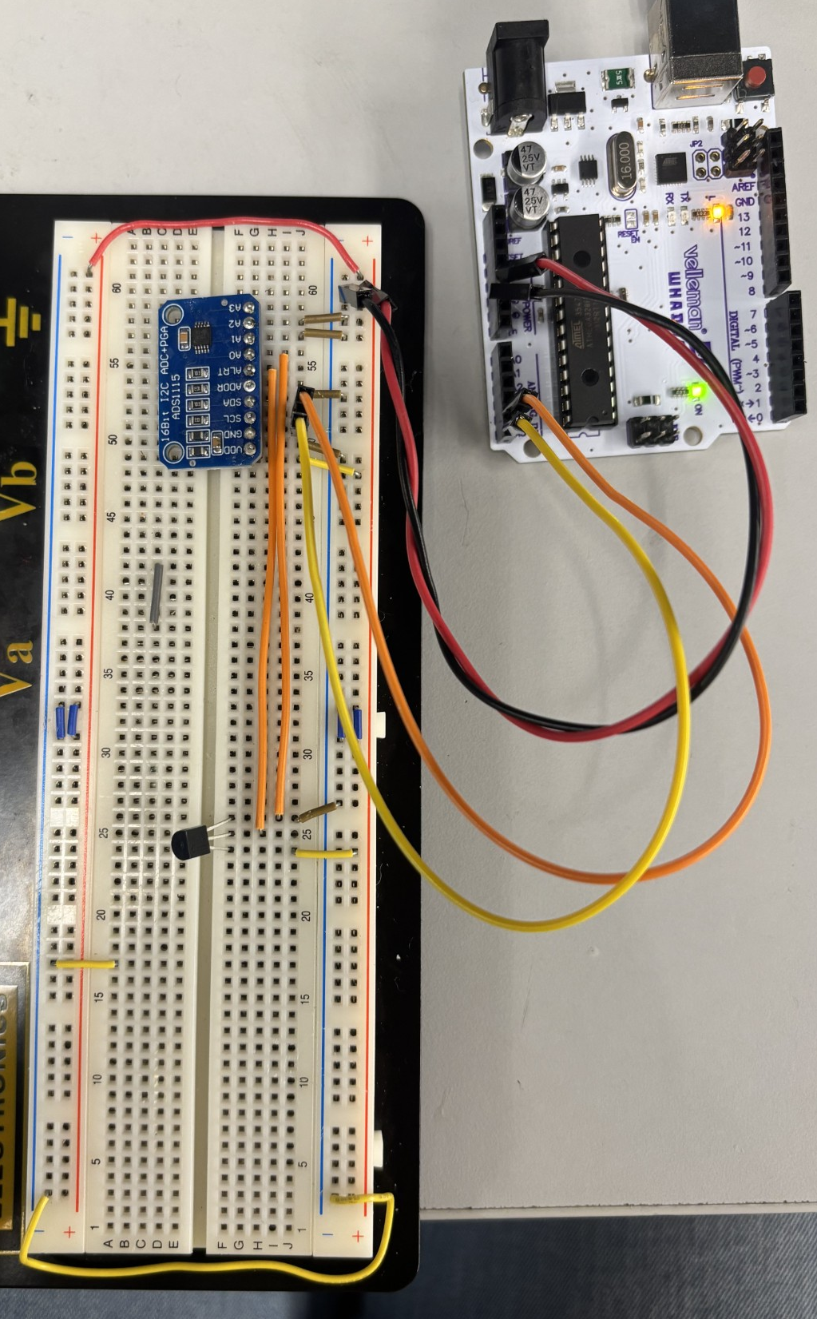
Setup and Test Execution
To run this test, we connected the Vout of the TMP36 to the AIN0 of the ADS1115 to read the temperature/voltage output measurements. We also connected AIN1 to the GND of the TMP36.
The differential voltage measurement is taken between AIN0 and AIN1 and the single ended voltage was measured between the AIN0 pin and local ground near the ADS1115.
The temperature measured at 740 mV with the differential measurement can be calculated as:
  Temp(˚C) = 0.74V - 100˚C/V - 50˚C = 24 ˚C
  23 ˚C *1.8 +32 = 75.2 ˚F

Slide 4
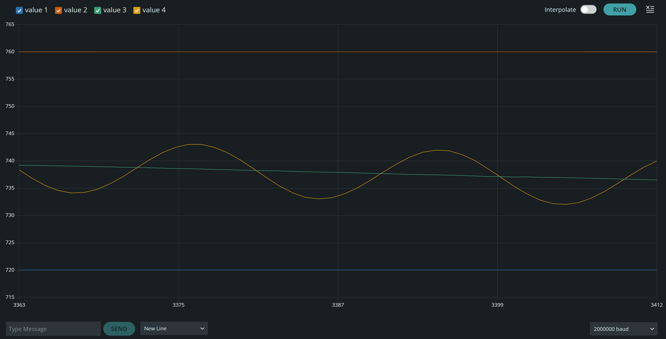
Results
Value 1 – Lower scale
Value 2 – Upper scale
Value 3 – Differential voltage (mV)
Value 4 – Single-ended voltage (mV)
The measured voltage is approximately 740 mV, as expected. It is interesting to test how well the sensor is working by gently squeezing it and watching the temperature increase due to body temperature.
The measurement taken for the differential voltage measurement shows that we can avoid the noise injected into our system, while the single-ended voltage measurement includes our noisy sine wave signal.
The single ended voltage measurement had a difference of 10 mV in its peak-to-peak reading

Slide 5
Conclusion
By using a differential method for measuring the voltage reading from the temperature sensor, we can get less noise and a more accurate signal. However, this method needs 4 measurement points instead of two as in the single ended measurement, which can be problematic when implemented into PCBs as board space can be limited in many cases.
The recommended way of routing the differential pair from the sensor to the ADS1115 for lowest noise would be to measure between the sensor Vout and its ground pin.

Slide 6
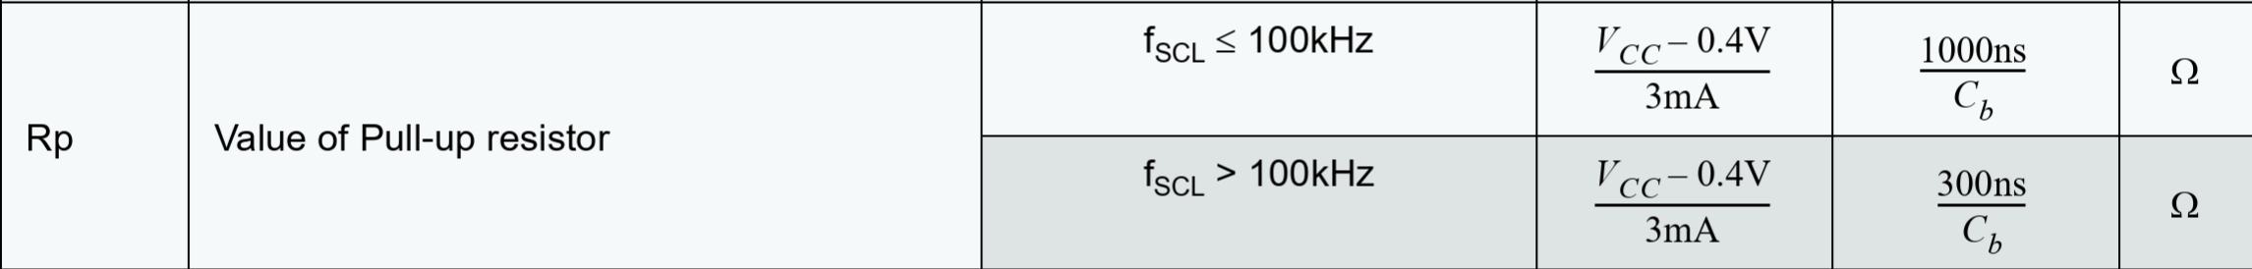
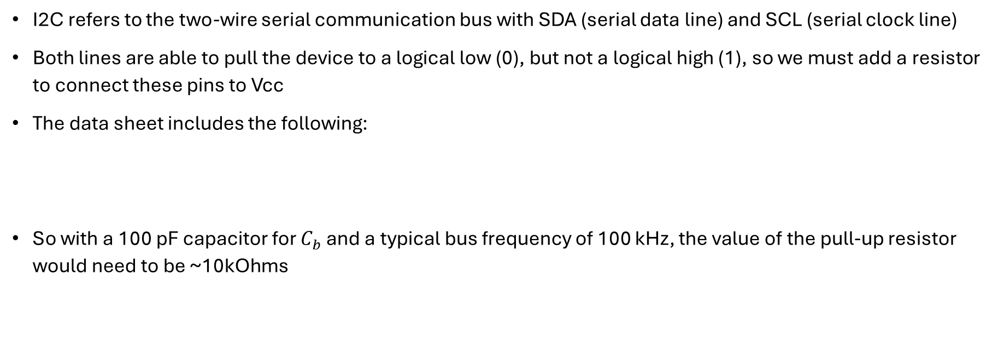
I2C pull up resistors
I2C refers to the two-wire serial communication bus with SDA (serial data line) and SCL (serial clock line)
Both lines are able to pull the device to a logical low (0), but not a logical high (1), so we must add a resistor to connect these pins to Vcc
The data sheet includes the following:
So with a 100 pF capacitor for $C_{b}$ and a typical bus frequency of 100 kHz, the value of the pull-up resistor would need to be ~10kOhms

